Slide 1

A Project Report On “MULTIPLE DISEASE PREDICTION” Presented by
MAYANK GUPTA (1901060113)
K SAI JATEEN DORA (1901060140)
KOTHAKOTA BHAVYA(1901060148)
Under the guidance of
Prof. MRS GITANJALI MISHRA(Supervisor)
DEPARTMENT OF COMPUTER SCIENCE & ENGINEERING
GIET UNIVERSITY, GUNUPUR-765022
2023

Slide 2

CONTENT
ABSTRACT
INTRODUCTION
PURPOSE
PROPOSED SYSTEM
SYSTEM ANALYSIS
DESIGN
HARDWARE REQUIREMENTS
SOFTWARE REQUIREMENTS
FUTURE SCOPE
CONCLUSION

Slide 3
CHART ABSTRACT
Machine learning and Artificial Intelligence are playing a huge role in today’s world. From self-driving cars to medical fields, we can find them everywhere.
The medical industry generates a huge amount of patient data which can be processed in a lot of ways. So, with the help of machine learning, we have created a Prediction System that can detect more than one disease at a time.
Many of the existing systems can predict only one disease at a time and that too with lower accuracy. Lower accuracy can seriously put a patient’s health in danger. We have considered four diseases for now that are Heart, Diabetes, Parkinson's and Breast Cancer and in the future, many more diseases can be added.
The user has to enter various parameters of the disease and the system would display the output whether he/she has the disease or not. This project can help a lot of people as one can monitor the person's’ condition and take the necessary precautions thus increasing the life expectancy

Slide 4
INTRODUCTION
In this digital world, data is an asset, and enormous data was generated in all the fields. Data in the healthcare industry consists of all the information related to patients. Here a general architecture has been proposed for predicting the disease in the healthcare industry. Many of the existing models are concentrating on one disease per analysis. Like one analysis for diabetes analysis, one for cancer analysis, one for heart disease and other for Parkinson's like that.
There is no common system present that can analyze more than one disease at a time. Thus, we are concentrating on providing immediate and accurate disease predictions to the users about the symptoms they enter along with the disease predicted. So, we are proposing a system which used to predict multiple diseases by using Machine Learning and streamlit .

Slide 5
CONTINUE
To implement multiple disease prediction systems we are going to use machine learning algorithms, and Django. Python pickling is used to save the behavior of the model.
The importance of this system analysis is that while analyzing the diseases all the parameters which cause the disease is included so it is possible to detect the disease efficiently and more accurately.
The final model's behavior will be saved as a python pickle file.

Slide 6
PURPOSE
A lot of analysis over existing systems in the healthcare industry considered only one disease at a time.
Maximum systems focus on a particular disease. When an organization wants to analyze their patient’s health reports then they have to deploy many models.
The approach in the existing system is useful to analyse only particular diseases. In multiple diseases prediction system a user can analyse more than one disease on a single website.
The user doesn’t need to traverse different places in order to predict whether he/she has a particular disease or not.
In multiple diseases prediction system, the user needs to select the name of the particular disease, enter its parameters and just click on submit. The corresponding machine learning model will be invoked and it will throw the predictive result.

Slide 7
PROPOSED SYSTEM
In multiple disease prediction, it is possible to predict more than one disease at a time.
So the user doesn’t need to traverse different sites in order to predict the diseases.
We are taking four diseases that are Diabetes, Heart, .Parkinson’s and Breast Cancer disease Analysis .
As all the four diseases are correlated to each other.
To implement multiple disease analyses we are going to use machine learning algorithms and Streamlit.
When the user is accessing this API, the user has to send the parameters of the disease along with the disease name.
Streamlit will invoke the corresponding model and returns the status of the patient.

Slide 8
SYSTEM ANALYSIS
FUNCTIONAL REQUIREMENT :
The system allows the patient to predict the disease .
The user adds the input for the particular disease and based on the trained model of the user input the output will be displayed .
NON FUNCTIONAL REQUIREMENT:
The website will provide range of the values during the prediction of the disease.
The website should be reliable and consistent.
, written using angle brackets.

Slide 9
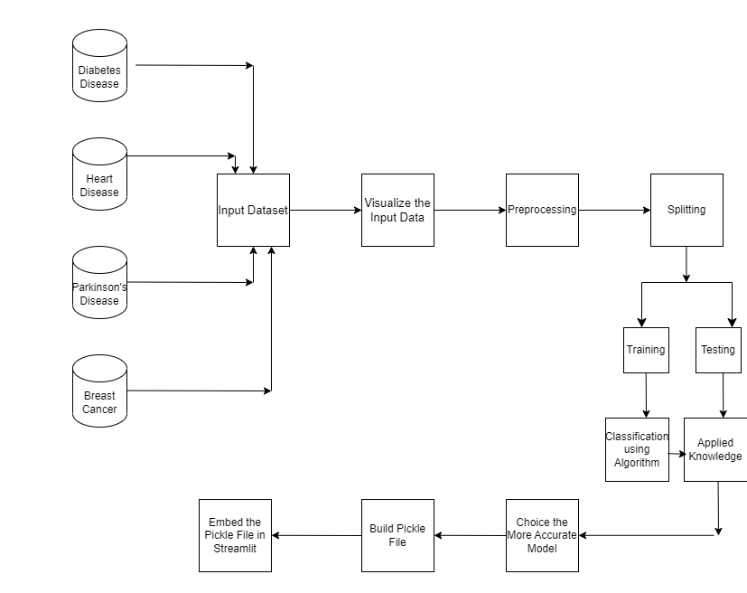
DESIGN

Slide 10
REQUIREMENTS
SOFTWARE REQUIREMENTS:-
WEB SERVER :STREAMLIT
IDE :PYTHON IDLE
ENVIRONMENT : SPYDER
BROWSER :GOOGLE CHROME.

Slide 11
TECHNOLOGY USED
LANGUAGE :PYTHON
ALGORITHM :MACHINE LEARNING
SERVER : STREAMLIT
BROWSER :GOOGLE CHROME

Slide 12
FUTURE SCOPE
In the future we can add more diseases in the existing API.
We can try to improve the accuracy of prediction in order to decrease the mortality rate.

Slide 13
CONCLUSION
The main objective of this project was to create a system that would predict more than one disease and do so with high accuracy. Because of this project the user doesn’t need to traverse different websites which saves time as well.
Diseases if predicted early can increase your life expectancy as well as save you from financial troubles.
For this purpose, we have used various machine learning algorithms like SVM(Support Vector Machine) and Logistic Regression to achieve maximum accuracy.

Slide 14



